Slide 1
Final Project CIT 190
Donna Curiel

Slide 2
Interface Design
The Jungle Games are designed for all people who want to have fun
The Movable Parrot game is designed for younger children
Buzzy the Flying Bee is designed for everyone
Fluttering Butterflies is for all ages

Slide 3
Interactive Features
The menu buttons display the path to get to the game
The curser hand shows up when you hover over the button
The buttons are giant, front and center for ease of use
The sound effects enhance the user experience
The sound effects are quite a surprise when little Buzzy doesn’t make it

Slide 4
Interface Design
Layout Selection
The flex direction was used because it is responsive
The menu is responsive also with extra margin space to keep the buttons separated
The simple color scheme of Buzzy Bee makes it easy to navigate

Slide 5
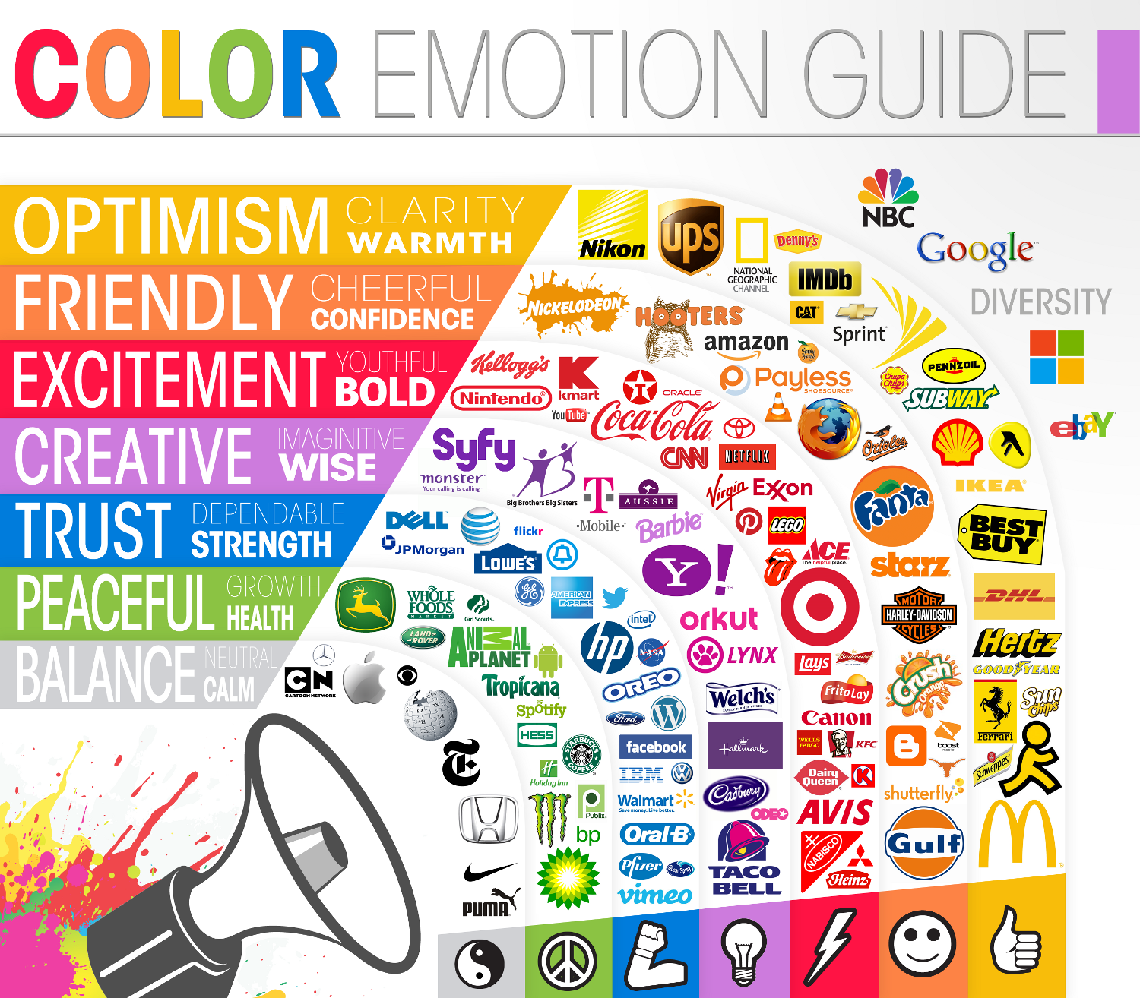
Color Scheme
A monochromatic color scheme
is used on the opening page.
The greens create peace.
The yellow creates optimism.
Buzzy Bee has blue for a trusting feeling and red for excitement to get to the poppies

Slide 6
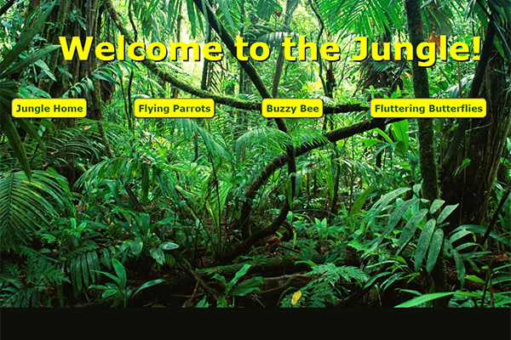
I want people to have fun playing my games. The Jungle games create a sense of wonder of a land far away. One of the goals is to expose children to different places in the world. Jungle games will also spark creativity in children as they move the parrots around to create their own jungle scene.

Slide 7
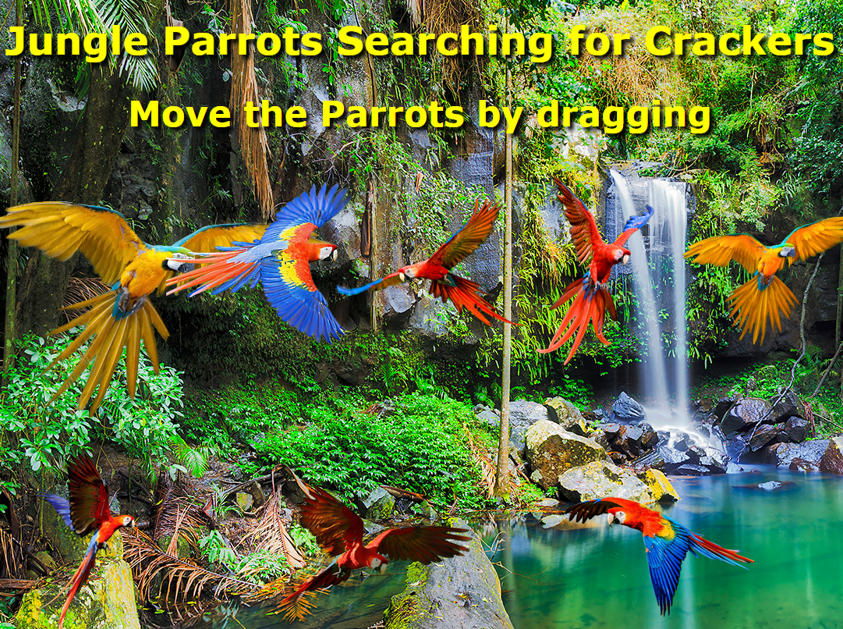
The jungle parrots are very fun for all people. The bright primary colors bring a sense of excitement. Children can be very creative as they move the parrots around to design their own jungle.

Slide 8

Menu Design
The menu is made from the <button> tag with a CSS class attached to it.
The <button> tag was used instead of the list tag to have optimal control of design and behavior.

Slide 9
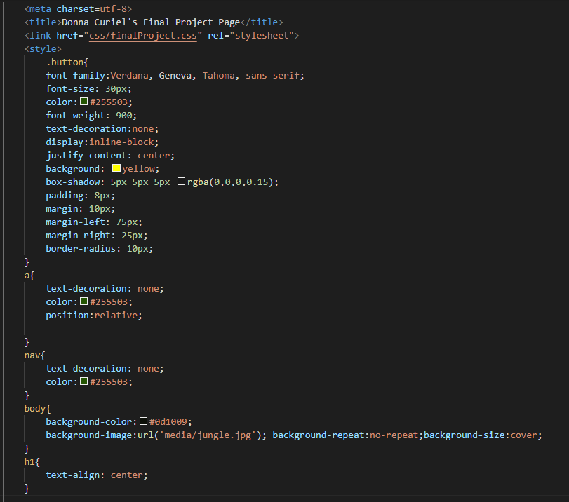
Coding Issues
The external CSS sheet was creating a problem for me.
Each game needed to have its own background
To solve that problem, I created a CSS class style tailored to the needs of each page.

Slide 10
Gaming Fun for Everyone
The Intended Audience for Buzzy Bee is Everyone
The Interactive Features are the Flying Buzzy Bee
The Ever-Changing Barriers Buzzy Flies Through
The Sound is Part of the Game when Buzzy Doesn’t Make it

Slide 11
Game Layout and Color scheme
I chose the game layout to be very clean and simple
Simple Blue-Sky Background with two Bright Red Poppies
The Buzzy Bee Needed to be Smaller to fit Through the Barriers
I Chose Colors with Great Contrast Between Game Pieces for Clear Visibility
User Experience is Enhanced by Clearly Seeing how to Navigate Between the Barriers

Slide 12
How to Play movable parrots
You click on a parrot and hold down the mouse as you move the parrot into the position of your choice.
Its that simple.
Movable Parrots is a creative game that allows users to create their own jungle scene.

Slide 13
Plans and progress on second game
The plans for the second game are completed.
Buzzy the Flying Bee is already completed.
I had many coding issues on the second game. The sound effects was one of my biggest problems. The sound did not work when I tested the file on my local computer. I finally gave up and put it on the server to just be done with it. Once it was on the server the sound worked.

Slide 14
Coding Problems for second game
I had problems with positioning of the game in the center
I resolved that by using absolute positioning with my CSS.
I lost the buttons and found them behind the game interface
I had problems with the sizing of the game window and photo background
My bee was too big to fit through any of the obstacles
I had to pull my bee through Photoshop to resize him to a smaller size
Photos for the obstacles were pixelated and never worked

Slide 16
